Slide 1
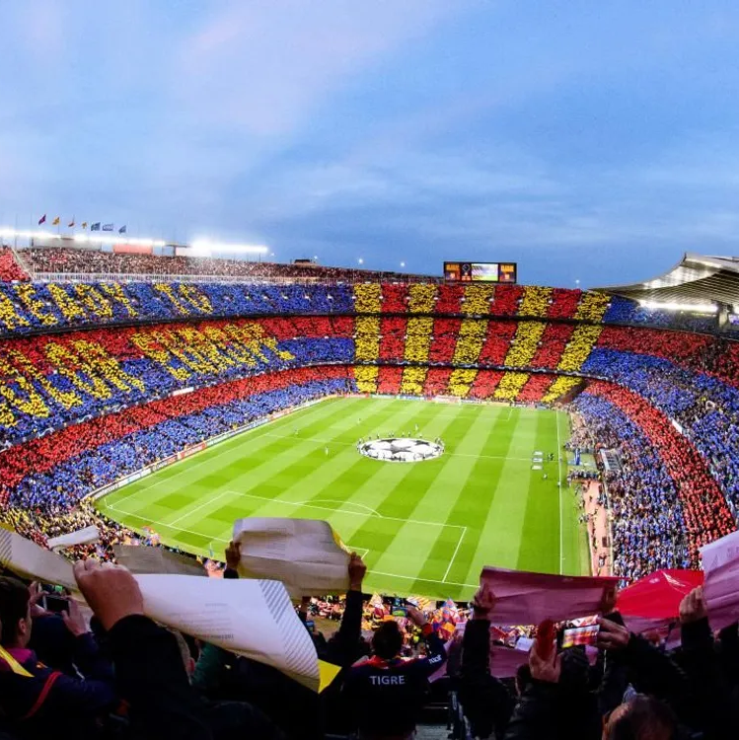

Player Recommendation Application
Capstone Project
Aditya Anandarajan

Slide 2
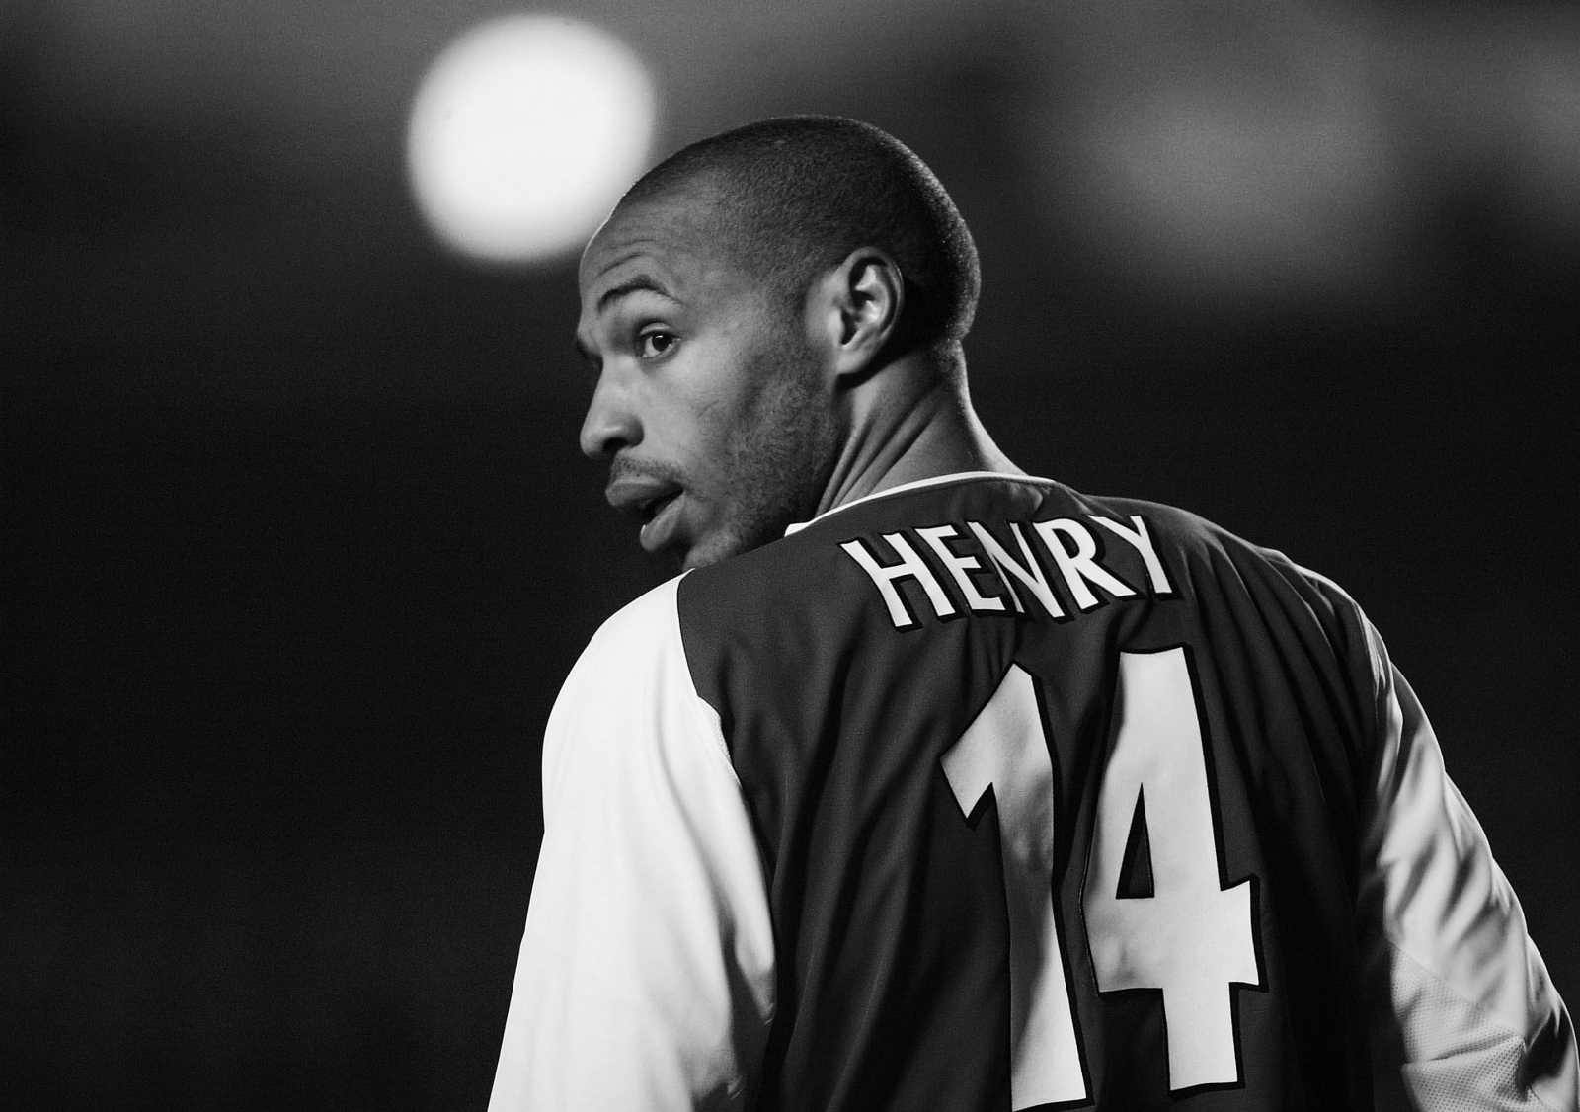
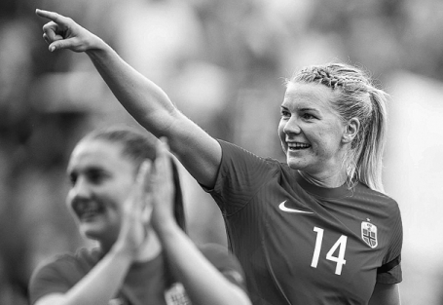
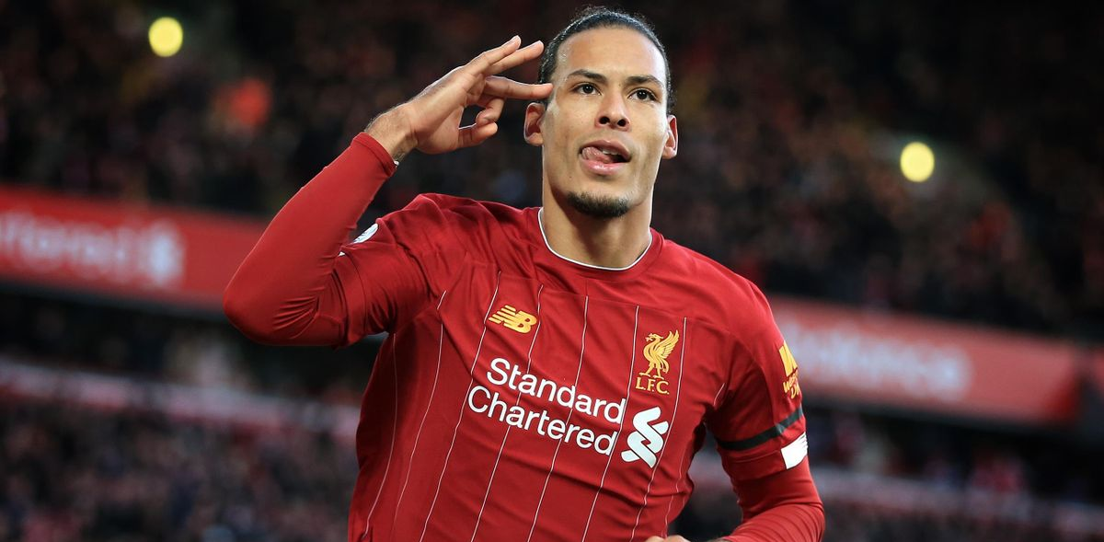
Contents
Background
Data Collection
Data Preparation
EDA
Feature Engineering
Modelling
Application
Evaluation
Limitations
Conclusion

Slide 3
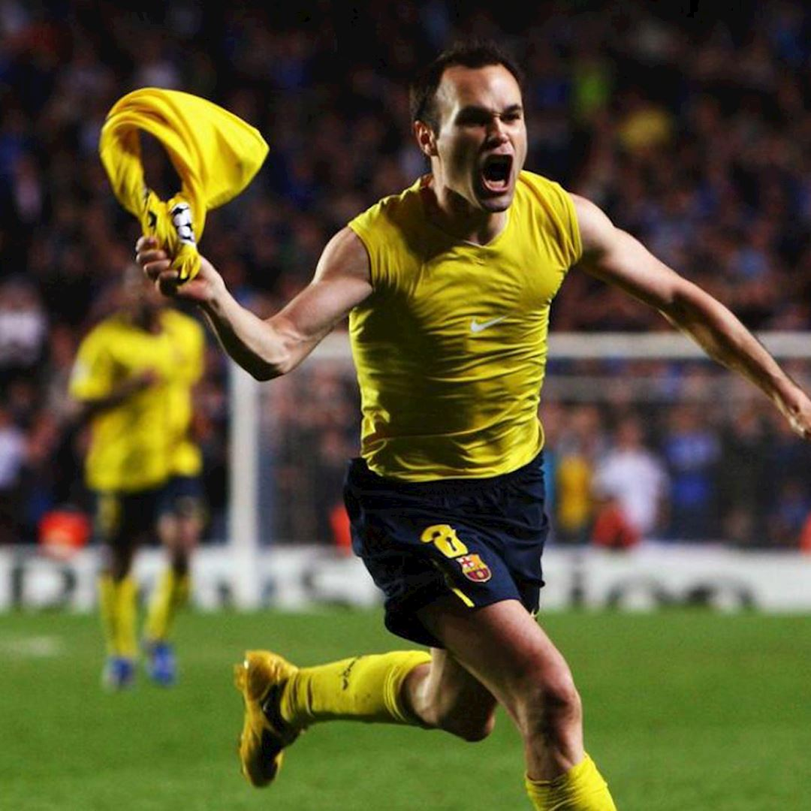
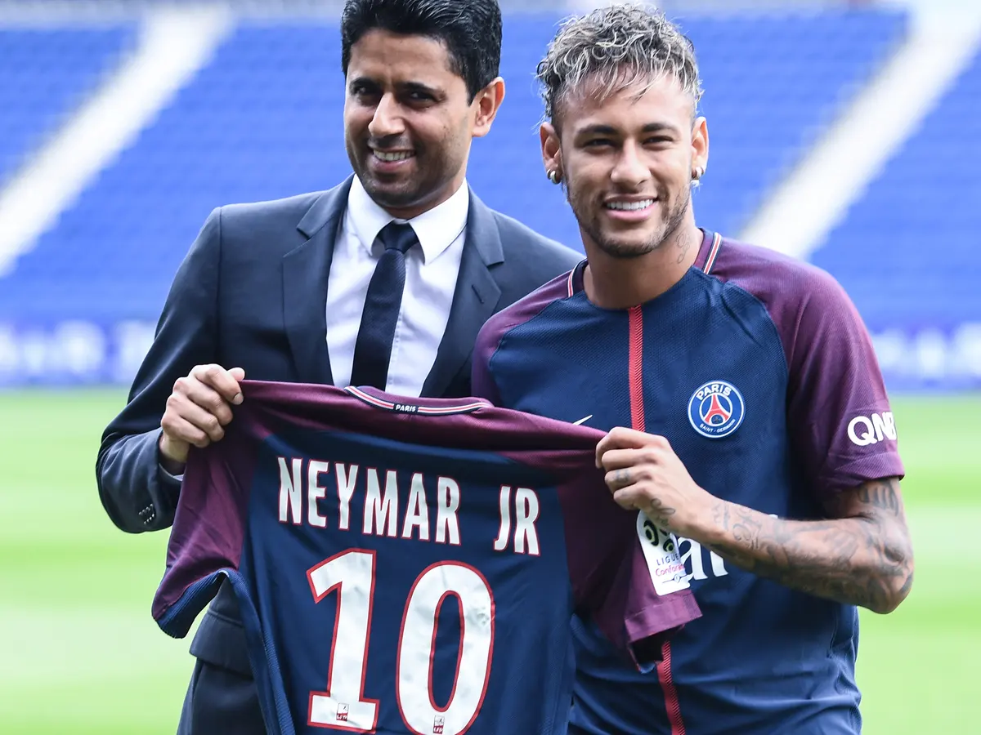
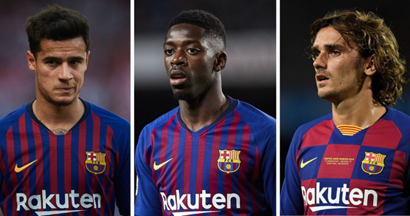
Background
Football Clubs find it hard to find the right players replacements
They tend to overspend and bring millions of debt.
The aim of this project is to use machine learning to find most similar players and build an application based on that model
Goals
the team needs a player who is like the player who is departing
Failure to sign their priority signing.
Replace one who is currently playing in a different position owing to an injury or another circumstance.
Notes:
The main motivation behind this project:
In order to replace Neymar and Iniesta, FC Barcelona spent more than 400 million pounds on just 3 player acquisitions in the years 2018 and 2019. And all three failed to replace and create an impact. This resulted in the club spending too much and bringing huge debts. Similarly, Manchester United has spent over £1 billion and has continued to struggle over the past decade.
The project aims to find solutions to the following problems:
Let's say player X departs a team, and the team needs a player who is similar to the player who is departing.
Clubs occasionally fail to sign their top transfer targets for a variety of reasons. Then they would have to choose the best alternate signing.
Coaches occasionally have to select a versatile player to replace one who is currently playing in a different position owing to an injury or another circumstance.

Slide 4
Process
2
Data preparation
3
EDA
4
Feature Engineering
5
6
7
Modelling
Evaluation
Application Development
1
Data Collection

Slide 5


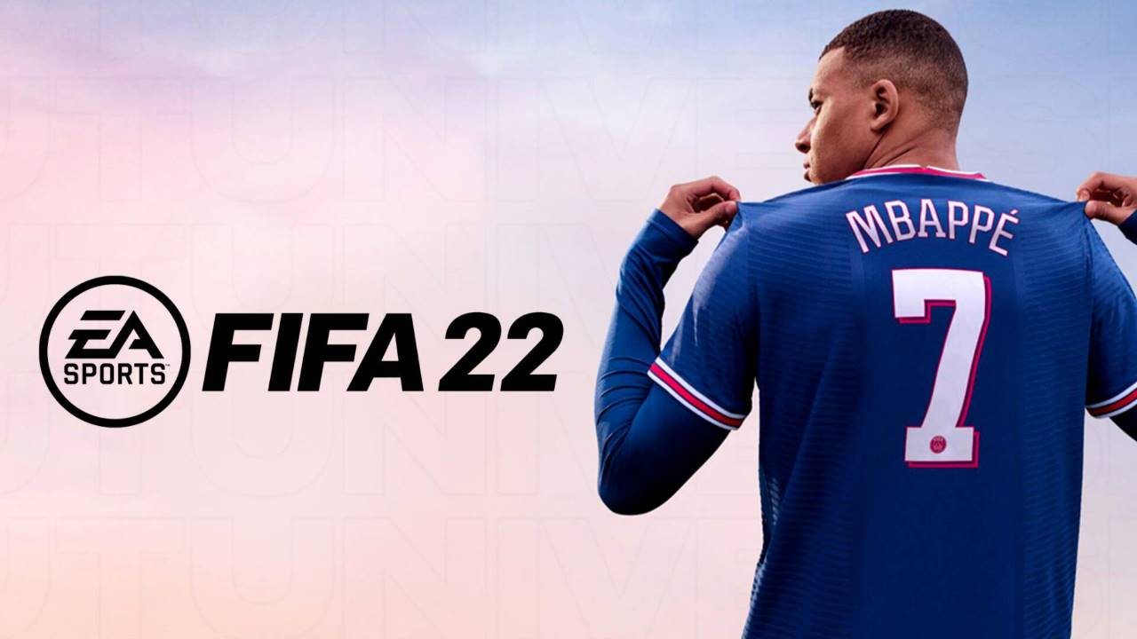
Data Collection
Initially the games FIFA 22 and Football Manager 2020 datasets from Kaggle were considered
Player abilities in FIFA 22 game data is on a scale of 0-100
FIFA 22 has well structured data for both male and female players
But in Football Manager 2020, the scale was different.
Due to time constraints, this project utilized FIFA 22 dataset as the primary dataset.
Notes:
In order to replace Neymar and Iniesta, FC Barcelona spent more than 400 million pounds on just 3 player acquisitions in the years 2018 and 2019. And all three failed to replace and create an impact. This resulted in the club spending too much and bringing huge debts. Similarly, Manchester United has spent over £1 billion and has continued to struggle over the past decade.

Slide 6
Data Preparation
The FIFA dataset had separate files for male and female players
Player dataset had 19239 rows and 110 columns, and the count of player abilities columns was over 50
Player abilities in FIFA 22 game data is on a scale of 0-100
The reduced Data format includes player abilities like dribbling, passing, shooting, pace, positioning etc.

Slide 7
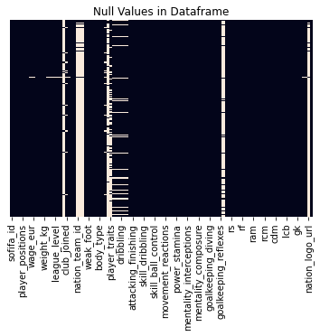
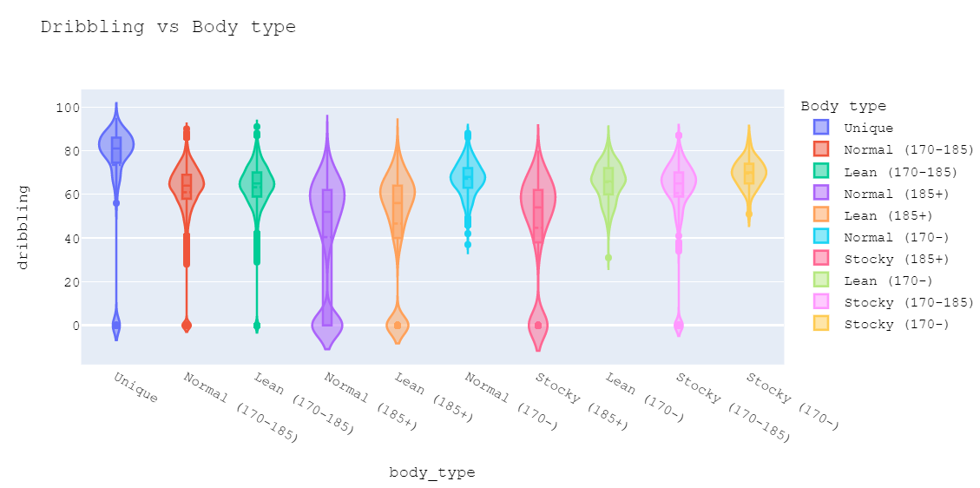
EDA
Notes:
After carrying out EDA it was observed that, 8 columns were having over 50% of null values
The heatmap show the null values in the respective columns.
Since there were many columns, I have chosen a few columns to show the analysis.
The violin plot shown in slide shows the relation bw body type and dribbling
The best dribblers like Messi and Neymar fall under the unique body type

Slide 8
Feature Engineering
Positional Versatility was considered, and a separate column was added to include no of positions
Work rate column was divided into 2 new columns
Label encoded columns 'preferred_foot', 'work_rate1', 'work_rate2', 'first_position','body_type'
27 player positions were identified
Filled the player abilities stats will null values with 0
Finally Shortlisted 50 player columns
Notes:
But there are 674 combinations of these positions in the dataset
This is because certain players are versatile and can play in multiple positions

Slide 9
Modelling
For modelling purposes, an unsupervised clustering approaches were used.
KMeans, KMeans(with PCA), Hierarchical Clustering and DBSCAN were used to cluster the players.
Separate modelling was done for male and female players
Notes:
From the EDA, it was calculated that there were 27 different player positions
As a result, techniques like silhouette coefficient were not used.

Slide 10
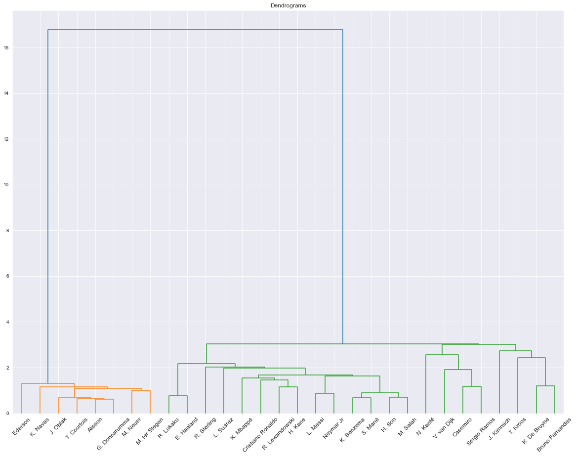
Modelling Hierarchical Clustering
An agglomerative approach using ‘ward’ linkage was used to cluster them hierarchically
Since Hierarchical Clustering is highly computationally intensive, only a small sample was used to generate the dendrogram
Notes:
From the EDA, it was calculated that there were 27 different player positions
As a result, techniques like silhouette coefficient were not used.

Slide 11
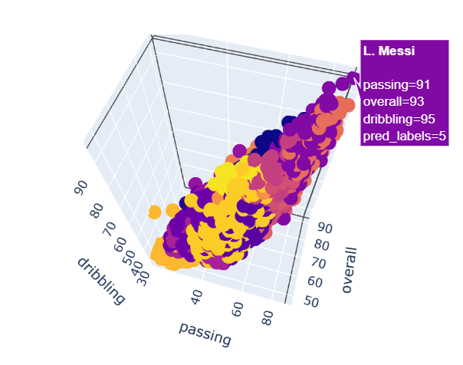
Modelling KMeans
KMeans clustering was performed in two ways:
With PCA
Without PCA
On Analysis, it was observed that the both results were almost identical while KMeans( with PCA) was computationally more efficient.
Notes:
From the EDA, it was calculated that there were 27 different player positions
As a result, techniques like silhouette coefficient were not used.
Instead, a no of k values > 11 were used to experiment
After carrying out PCA, it was seen that only the first 4 PCs had high variance.

Slide 12
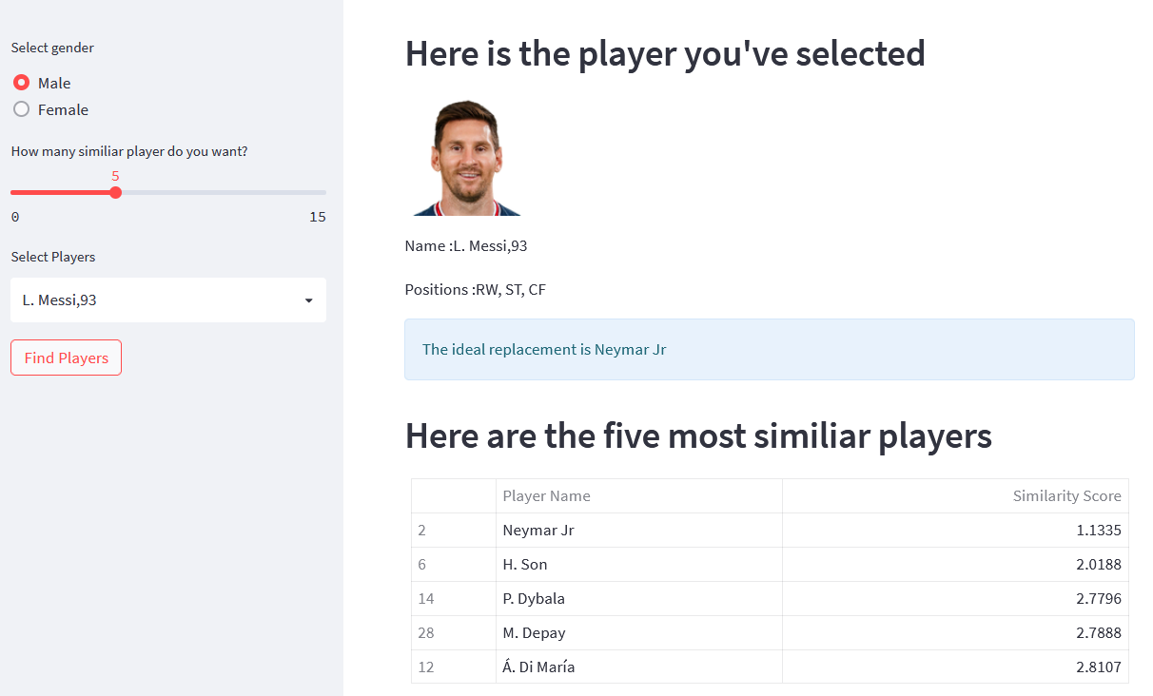
Application
A web application was built using the Streamlit framework
Users can select player gender, similar player count and the finally the chose the player from the dropdown
The most similar players would be shown in a table.
Notes:
For example,
When the player chosen was Lionel Messi
The application predicted that Neymar Jr was the ideal replacement to Lionel Messi.
This is a right prediction since Neymar is one of only few player whom we can compare to Messi in terms of technical abilities like dribbling, passing, ball control, scoring.

Slide 13
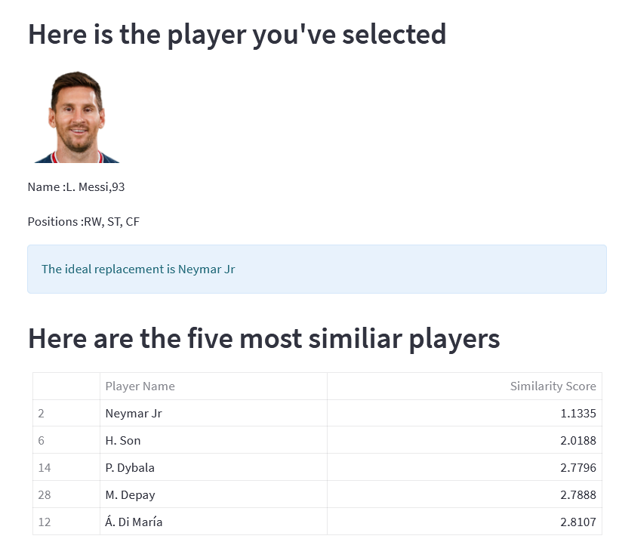
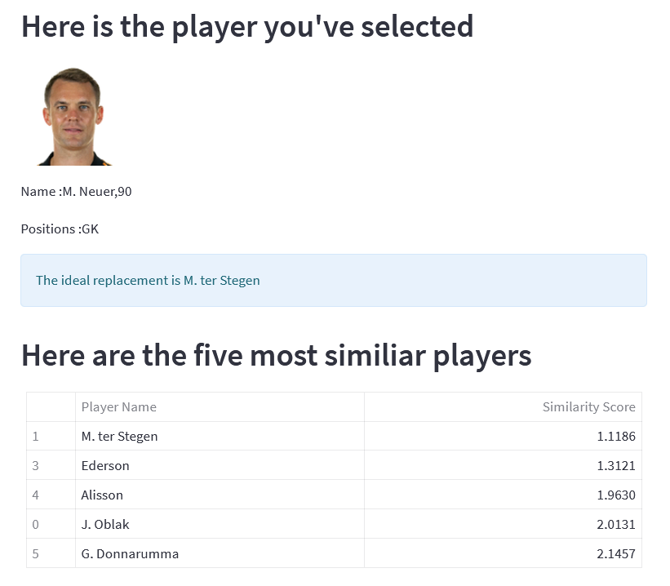
Evaluation
Notes:
For example,
When the player chosen was Lionel Messi
The application predicted that Neymar Jr was the ideal replacement to Lionel Messi.
This is a right prediction since Neymar is one of only few player whom we can compare to Messi in terms of technical abilities like dribbling, passing, ball control, scoring.

Slide 14
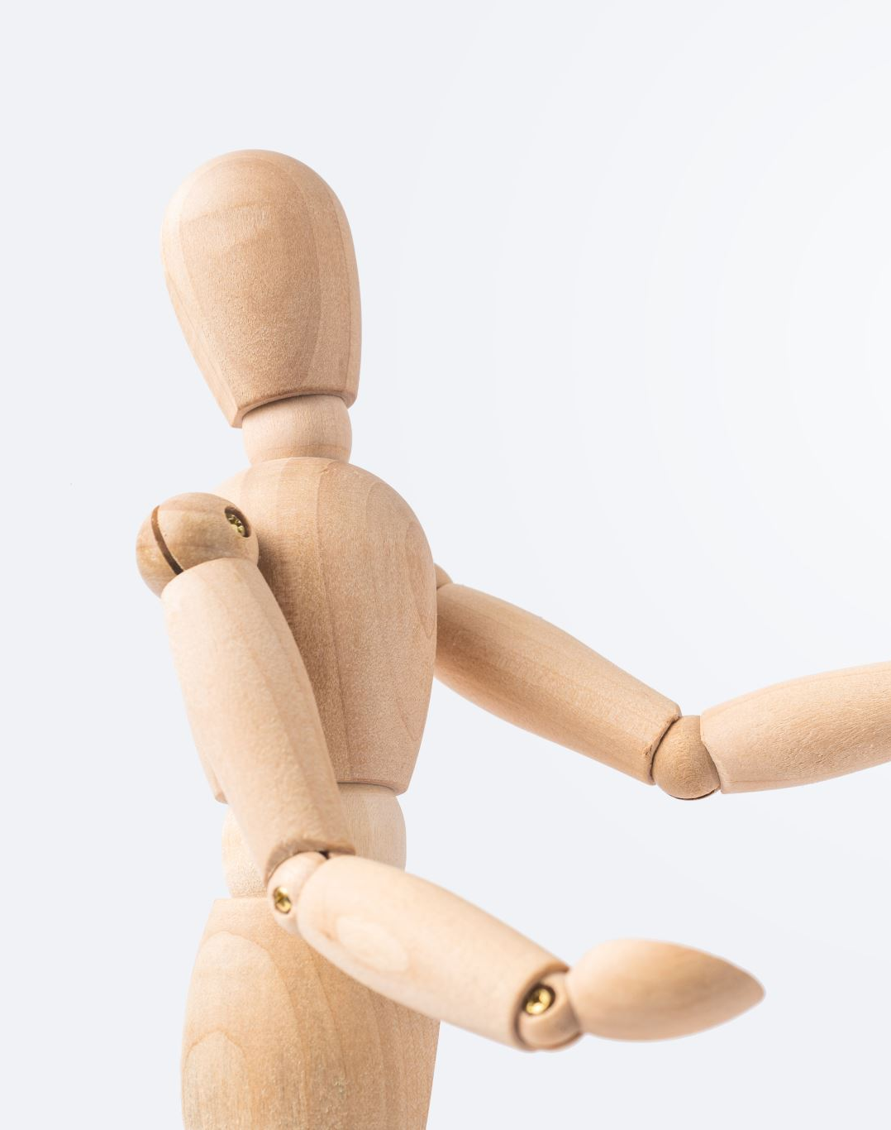
Limitations
It does not consider the current age and market value of the players
Do not consider whether players are injury prone.
Player linguistic and regional preferences.
Do not consider financial feasibility
Notes:
The model shows bias and gives less weightage to the original player positions and more on the technical abilities of the players.
It does not consider the current age and market value of the players while making recommendations.

Slide 15
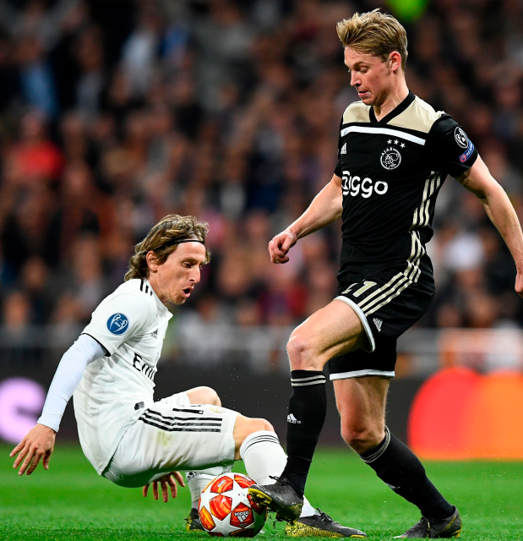
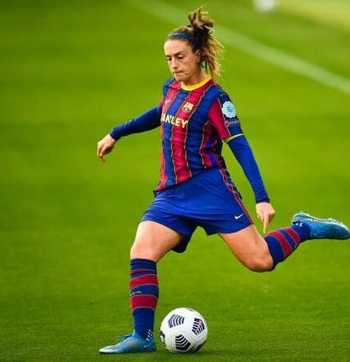
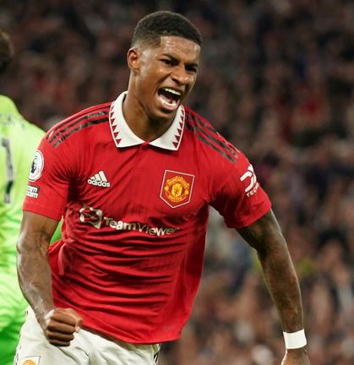
Conclusion
Achieve the initial goal of building an application to recommend similar players
Among the models, KMeans( with PCA) performed better both computationally and on knowledge-based evaluation.
Dataset bias was more observable for female players than male player data
Notes:
But the two players have historically played at different positions.

Slide 16
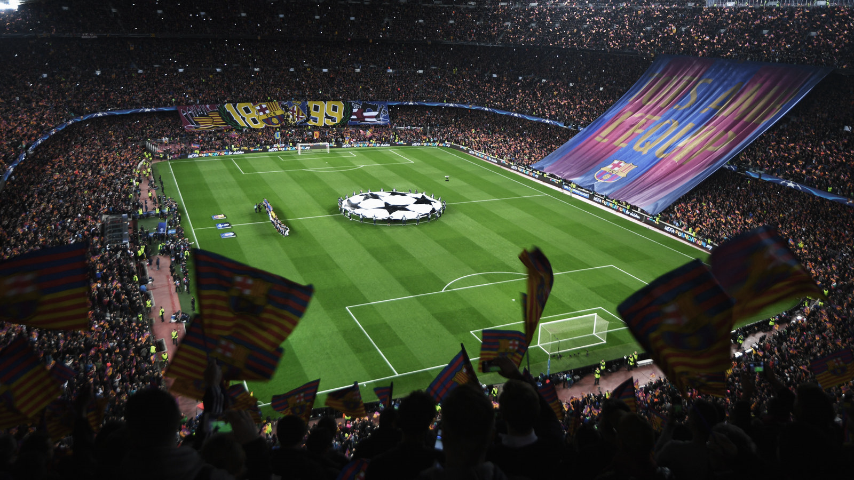
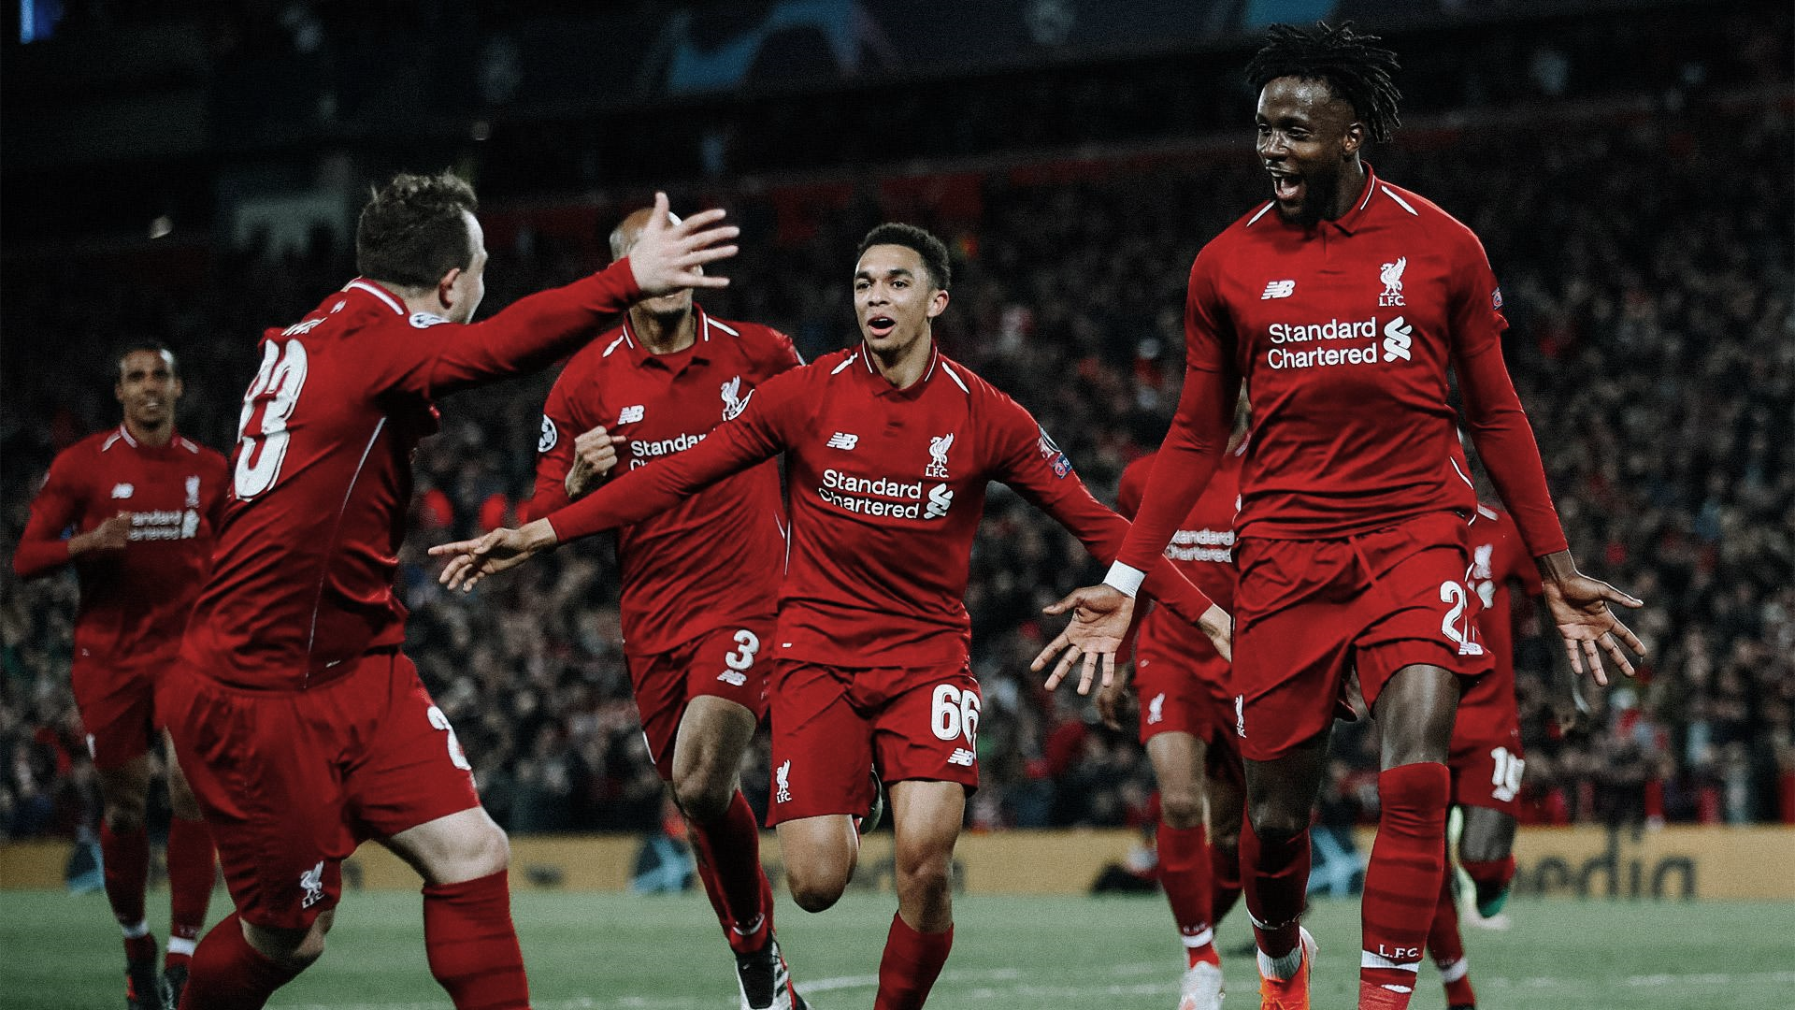
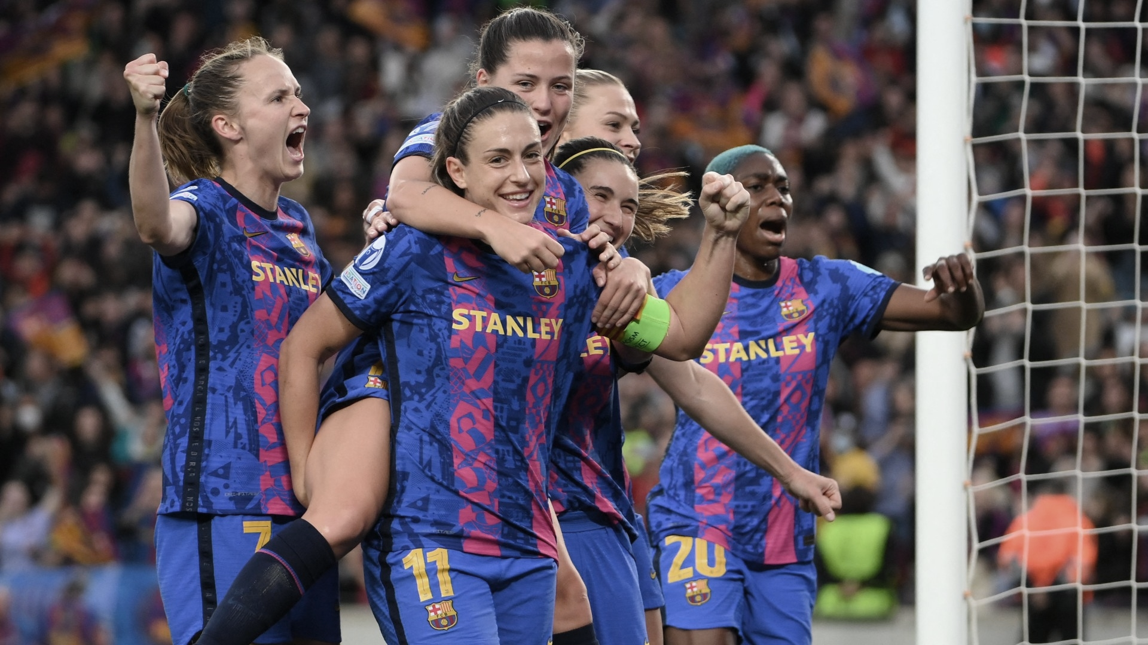
Thank you

